Slide 1
Iris Dataset Classification using Perceptron Model
Presented by:
VidhyaSagar

Slide 2
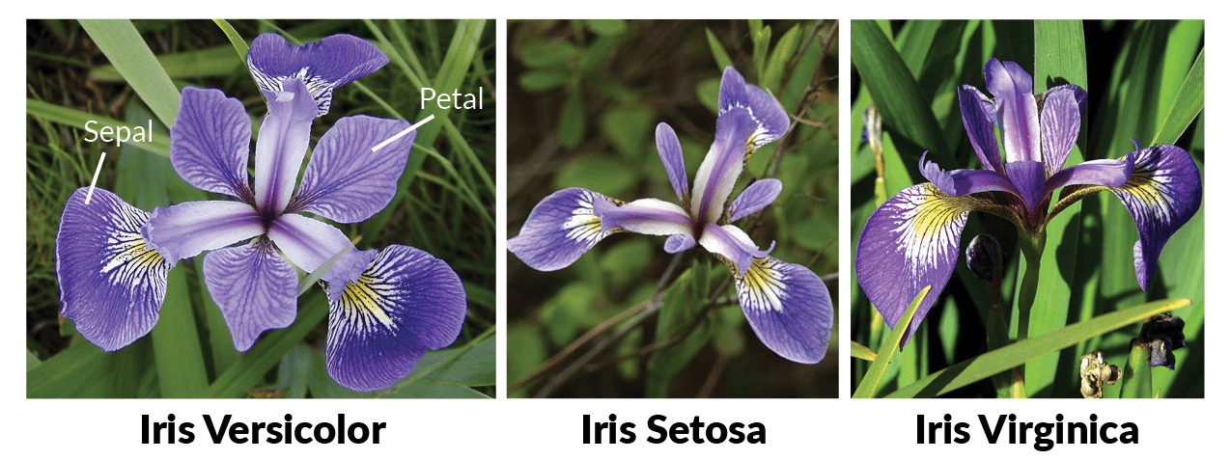
Iris Dataset Classification using Perceptron Model
Welcome to the "Iris Dataset Classification" project.
This project focuses on using the Perceptron model for classifying Iris dataset flowers.
Explore the journey of understanding, analyzing, and classifying Iris species.
Lets focus into the details of the Iris dataset and the application of the Perceptron Model.

Slide 3
Introduction to Iris Dataset
Importing Necessary Libraries:
Our journey begins with the import of essential libraries for analysis.
Key libraries include 'scikit-learn’ for machine learning tasks and ‘numpy' for numerical operations.
Loading and Visualizing the Iris Dataset
The Iris dataset is a classic dataset in the field of machine learning.
It comprises samples from three species of Iris flowers: Setosa, Versicolor and Virginica.
Each flower is described by four features:
0-Sepal Length
1-Sepal Width
2-Petal Length
3-Petal Width

Slide 4
Data Selection and Features
Choosing Relevant Features:
For a targeted analysis, we are selecting specific features from the Iris dataset.
Our focus lies on petal width (feature index 3) and sepal width (feature index 1).

Slide 5
Data Splitting
Training and Test Sets:
Our next step is to split the dataset into training and test sets, a crucial practice in machine learning.
We've allocated 70% of the data for training and 30% for testing to ensure a comprehensive evaluation.
Ensuring Stratified Sampling:
To maintain balanced classes, we employ stratified sampling during the splitting process.

Slide 6

Data Label Distribution
Analyzing Class Distribution:
Before proceeding, let's take a closer look at the distribution of class labels in our dataset.
Understanding the balance of class labels is crucial for interpreting our model's performance.
np.bincount(y) counts the occurrences of each unique value in the array y, which represents the class labels of the entire dataset.
np.bincount(y_train) and np.bincount(y_test) perform the same counting for the training and test sets, respectively.
These counts help you understand the distribution of class labels in each set, ensuring that your dataset and subsets are balanced. Balancing is crucial, as imbalanced datasets may lead to biased model training and evaluation.

Slide 7
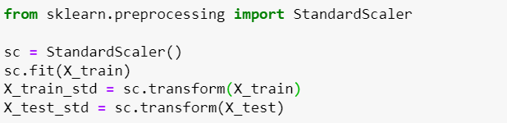
Data Standardization
Scaling Features:
Now, we move on to a critical preprocessing step—standardizing the features for uniformity and enhanced model performance.
Utilizing StandardScaler, we scale our features to have a mean of 0 and a standard deviation of 1. It is good practice for improving the performance, stability, and interpretability of machine learning models. It ensures that the features are in a consistent and comparable scale, allowing the model to learn and generalize more effectively.

Slide 8
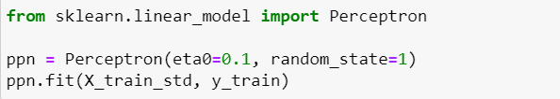
Perceptron Model Training
Learning from Data:
With our data standardized and ready, it's time to look into model training.
We are training a Perceptron model using the standardized training data.

Slide 9
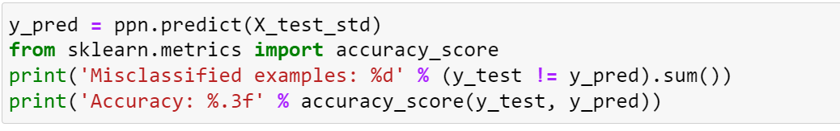
Model Evaluation
Assessing Performance:
Our Perceptron model is now trained, but how well does it perform on unseen data?
Let's predict on the test set and evaluate the model's accuracy.

Slide 10
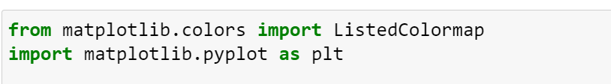
Decision Regions Plot
Visualizing Classification:
Let's bring the classification to life by plotting the decision regions of our Perceptron model.
We'll showcase how the model separates different classes in the feature space and visualize the class examples.

Slide 11
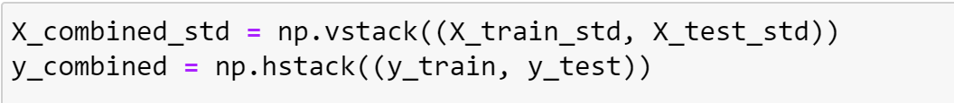
Combined Datasets
Visualization of Training and Test Sets:
To provide a comprehensive view, we combine the datasets used for training and testing.
This allows us to visualize the decision regions across the entire feature space.

Slide 12
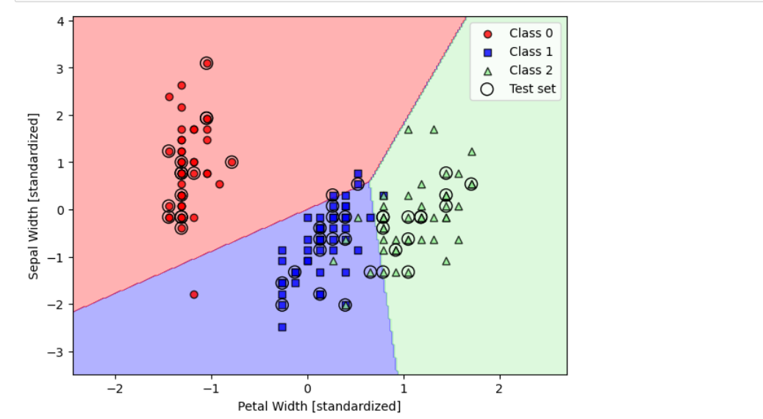
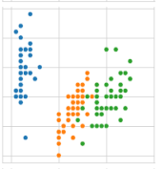
Observation(s):
Using sepal_length and sepal_width features, we can distinguish Setosa flowers from others.
Separating Versicolor from Viginica is much harder as they have considerable overlap.

Slide 13
Conclusion
Summary and Results:
petal_length and petal_width are the most useful features to identify various flower types.
While Setosa can be easily identified (linearly seperable), Virnica and Versicolor have some overlap (almost linearly seperable).
We can find "lines" and "if-else" conditions to build a simple model to classify the flower types.

Slide 14
Thank You All

